Slide 1
Creation of Trip Planner Bot and Facial Emotion Detection
By
Samik Hafeez(22062361)
Ahmed Bokhari
Ramanpreet Kaur(22073118)

Slide 2
Table of Content
Introduction
Methodology (SDLC use) Problem Solving
Functional and Non-Functional requirements
Visuals and Design Diagrams
Data Creation and Updation
Coding
Use of TDD
Risk Assessment Tables
Aims, Objectives and deliverables
Teamwork Contribution and Discussion
Sprint Plan
Use of evaluation metrics
Summary
References

Slide 3
Introduction
In this presentation we will discuss how we created Trip Planner bot and Facial Emotion Detection.
We will also explain the code that we used to implement both Trip planner bot and Facial Emotion Detection.
We will mention steps we used to produce the design and the solution.

Slide 4
Methodology
SDLC was used development for the Trip Planner Bot and Facial Emotion Detection.
The Definition of SDLC
“ The process of planning, creating, testing and deployment of the information system.”(Wikipedia).

Slide 5
FUNCTIONAL & NON-FUNCTIONAL REQUIREMENTS
Functional Requirements
The use of python and its external libraries.
User Intent Recognition.
Dataset Creation.
Dataset Exploration.
Face Detection & Recognition.
Response Generation.
Perform as expected.

Slide 6
FUNCTIONAL & NON-FUNCTIONAL REQUIREMENTS
Non-Functional Requirements
The code should follow python programming standards.
Efficient execution.
Data Security.
User Friendly Interface.
User Flexibility.

Slide 7
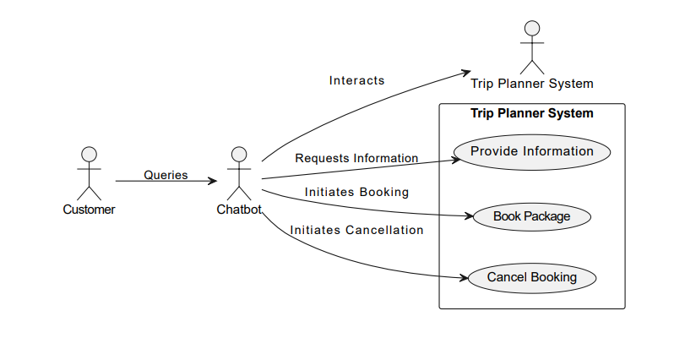
Visual & Design Diagrams
For Trip Planner Bot.

Slide 8
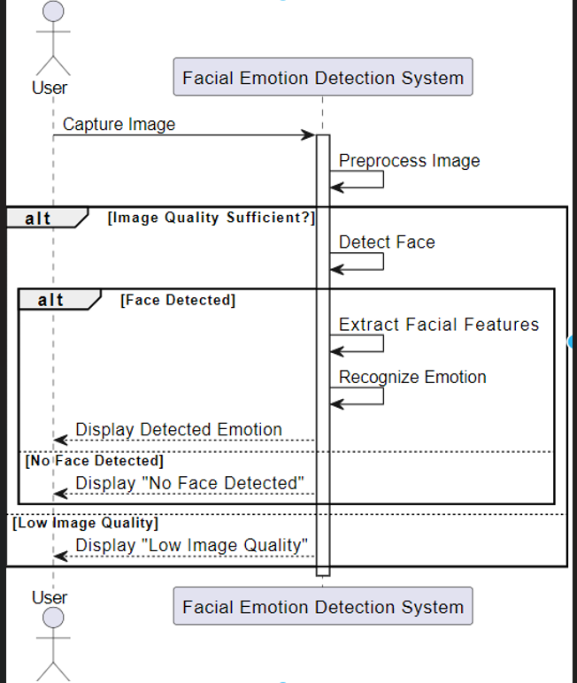
Visual & Design Diagrams
Facial Emotion Recognition

Slide 9
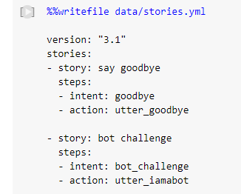
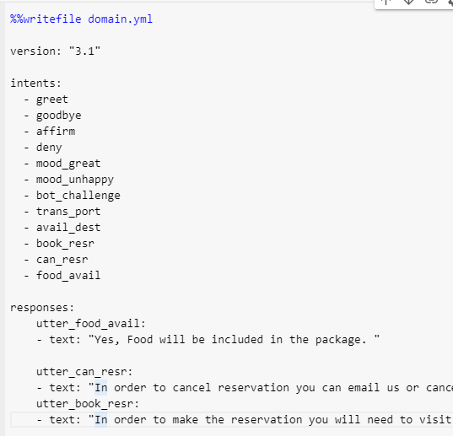
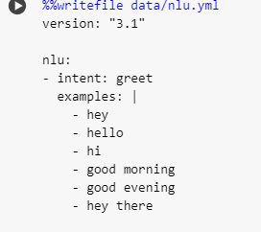
Data Creation and Updation.
For Trip Planner Bot

Slide 10
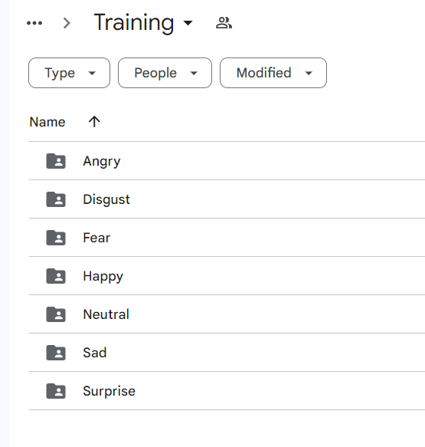
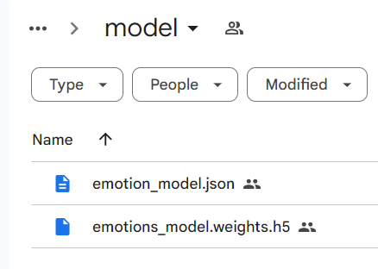
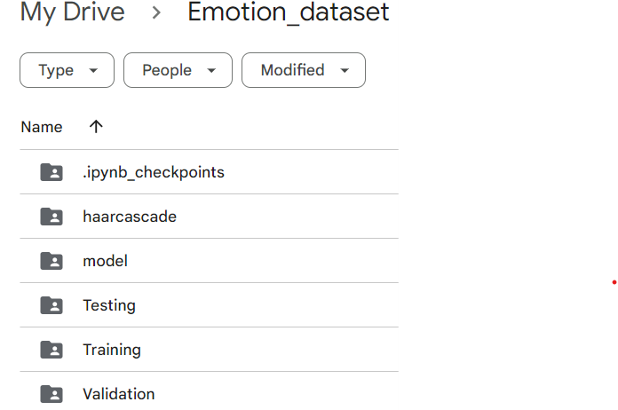
Data Creation and Updation.
For Facial Emotion Detection
We first converted FER-2013 into PNG files format.

Slide 11
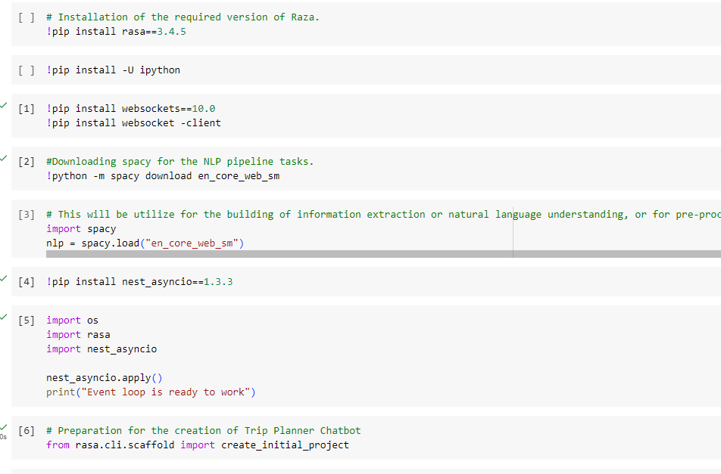
Coding
For Trip Planner

Slide 12
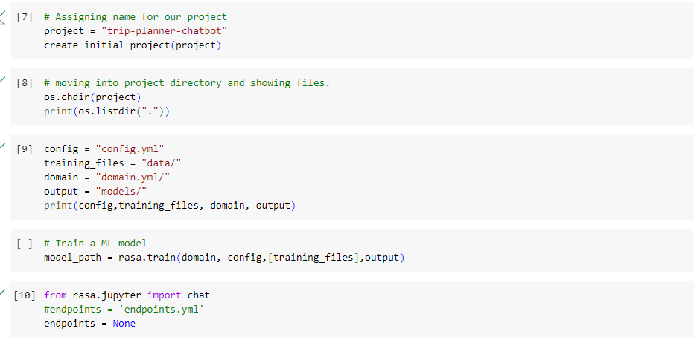
Coding
For Trip Planner

Slide 13
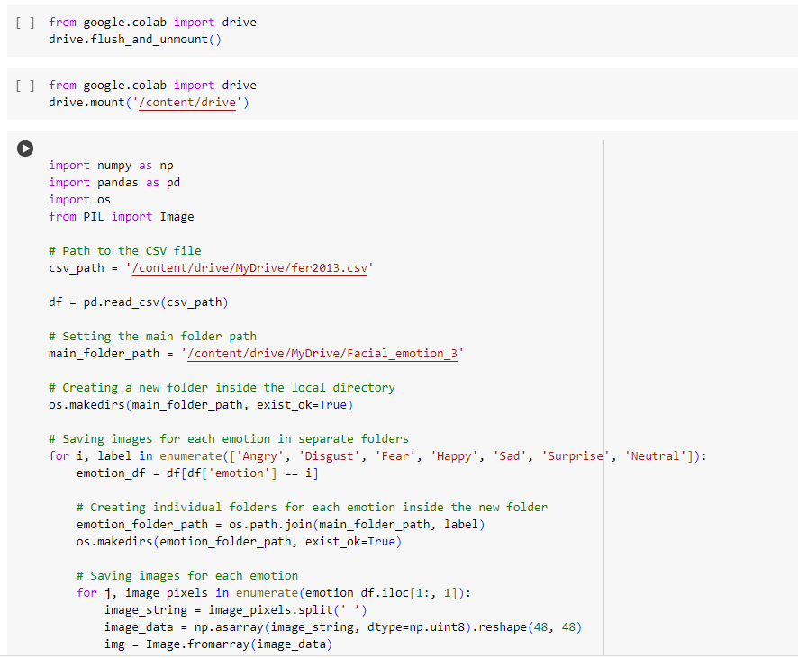
Coding
For Emotion Recognition

Slide 14
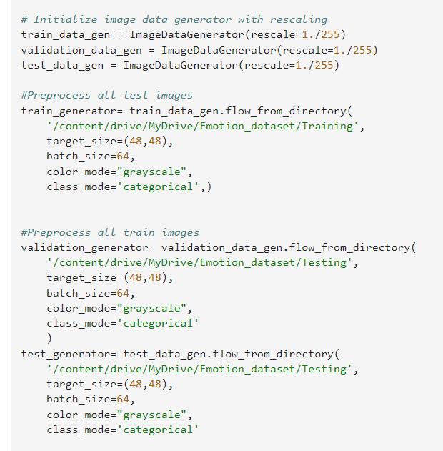
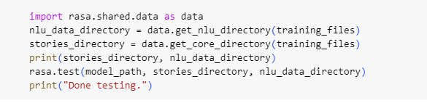
Use of TDD for testing
For Trip Planner Bot. For Facial Emotion Detection.

Slide 15
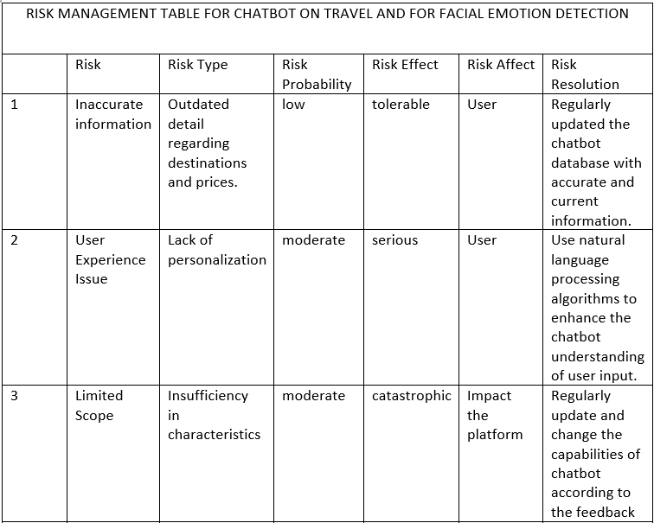
Risk Assessment Table

Slide 16
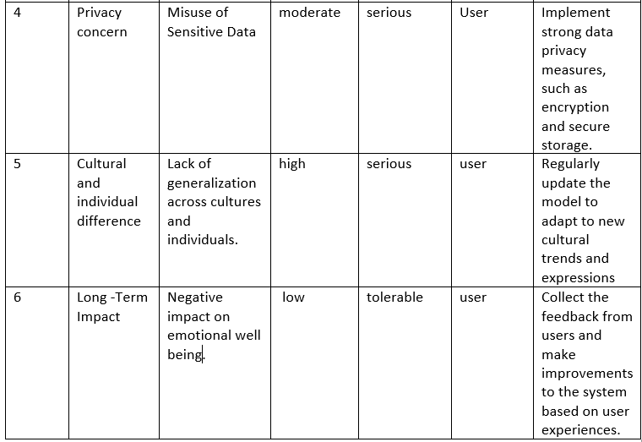
Risk Assessment Table

Slide 17
Aims, objectives and deliverables
Aims | Objectives
Trip planning Chatbot. | Creation of a simple chatbot that would help travelers plan their trips effortlessly, securely and efficiently from the comfort of their homes.
Face detection and recognition system. | Building an efficient Face Recognition and Detection system that would help identify people of all races and ethnicities.
Privacy assurance. | Implementing security measures to protect the facial recognition system from unauthorized access. Implementing security measures to protect customer travelling plans, history, data and maintain privacy.
Quality Control. | To ensure that the code is robust and works the best way possible. Maintaining and testing the code to ensure that it is free of errors and bugs.

Slide 18
TEAMWORK CONTRIBUTION TABLE
Team member | Project Stage | Contribution
Ramanpreet Kaur | Analysis | Determined necessary tools and objectives to complete the project.
Ahmed Bokhari | Design | Design the questions for trip chatbot and try to design the code for facial recognition.
Samik Hafeez | implementation | Create a chatbot and also did a coding part.
Ahmed Bokhari | Testing | Assured that project outcome was accurate.
Samik Hafeez | Evaluation | Dedicated toward the improvement and corrected the chatbot and coding where needed.

Slide 19
ROLES DISCUSSION(Belbin’s Team Role)
Specialist
Monitor evaluator
Implementor
CO- Ordinators
Team Worker
Resource Investigator

Slide 20
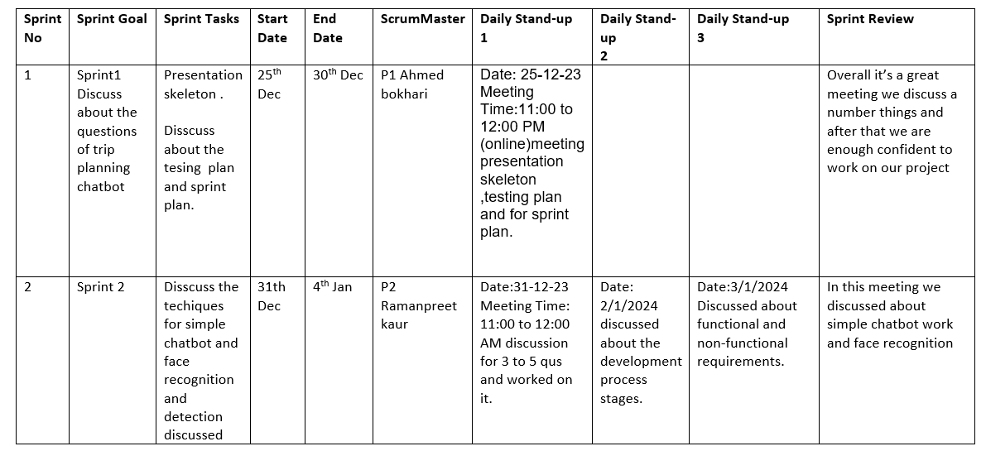
Sprint Plan

Slide 21
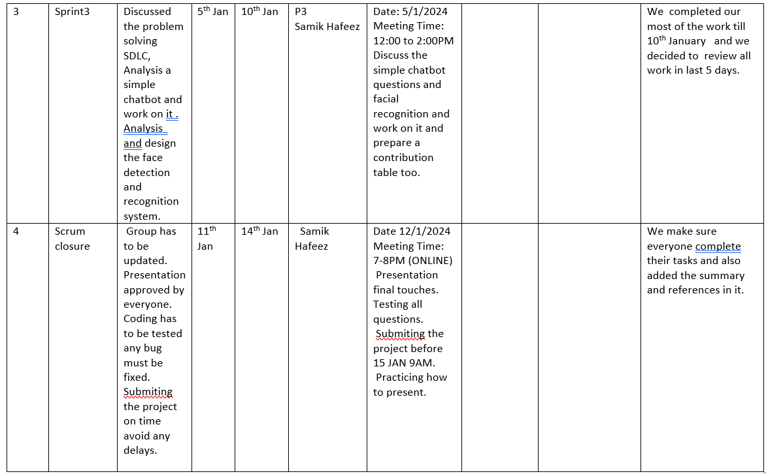
Sprint Plan

Slide 22
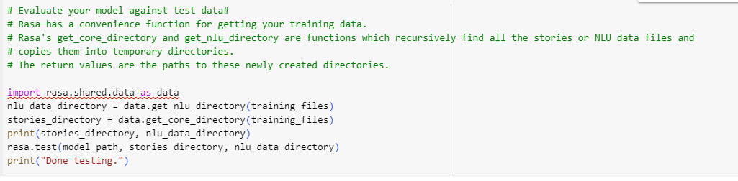
Use of Evaluation Metrics
For the Trip Planner Bot.

Slide 23
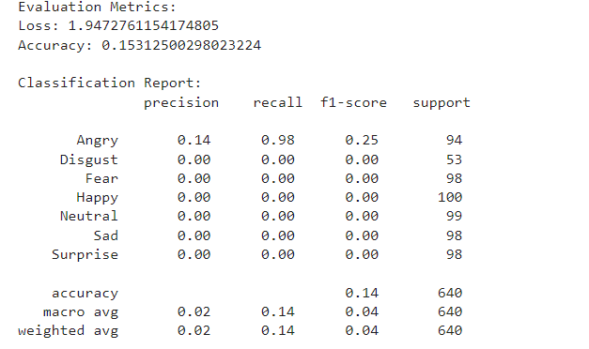
Use of Evaluation Metrics
For the Facial Emotion Detection.

Slide 24
Summary
In this presentation the creation of Trip Planner Bot and Facial Emotion Detection was done.
The solution was obtained using SDLC for both the apps.
Risk assessment table
Evaluation Metrics
Sprint Plan
Role Discussion
Team Contribution Table.

Slide 25
References
Wikipedia contributors. (2022, January7). Systems development life cycle. In Wikipedia. https://en.wikipedia.org/wiki/Systems_development_life_cycle
Belbin. (2022). About Belbin Team Roles. Available at: https://www.belbin.com/about/belbin-team-roles
Google Colab: A free, cloud-based Jupyter notebook environment. Available at: https://colab.research.google.com/ (Accessed: 15 January 2024)

